Slide 1
Analyzing meta-genomes and meta-transcriptomes using compositional data methods
🐯
🐞
👽
Greg Gloor
Department of Biochemistry
University of Western Ontario
ggloor@uwo.ca @gbgloor
https://github.com/ggloor/compositions/presentations

Slide 2
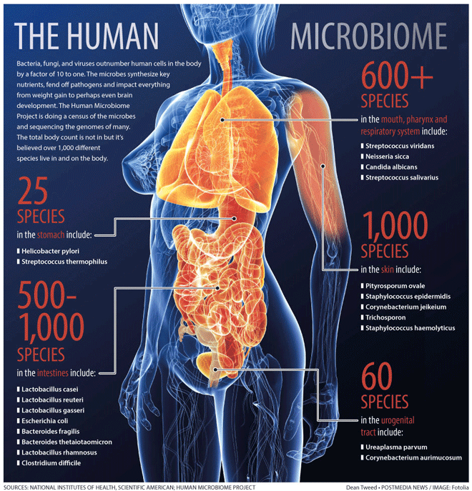
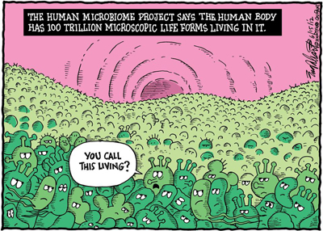
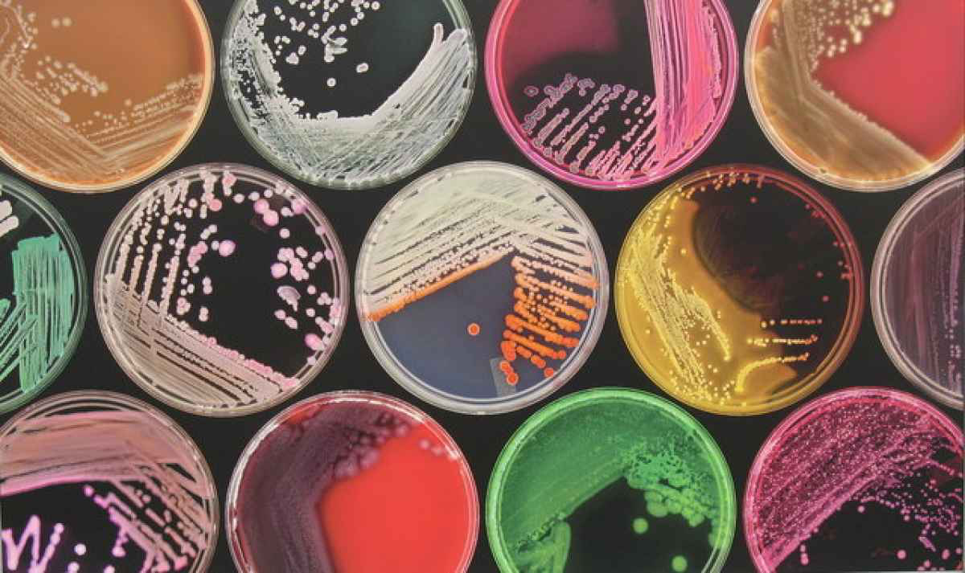
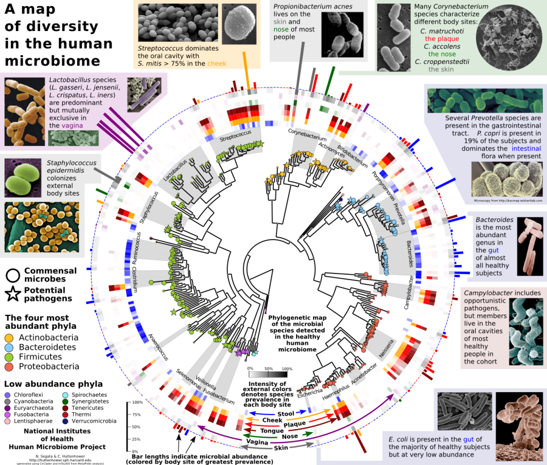
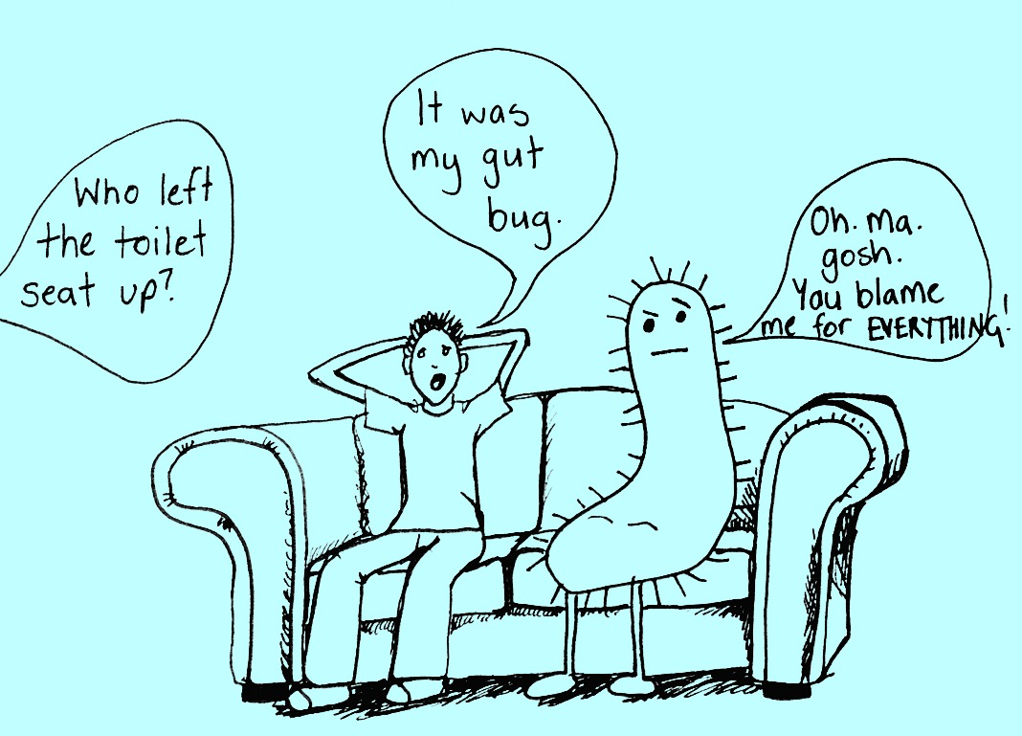
The microbiome
🐯
🐞
👽

Slide 3
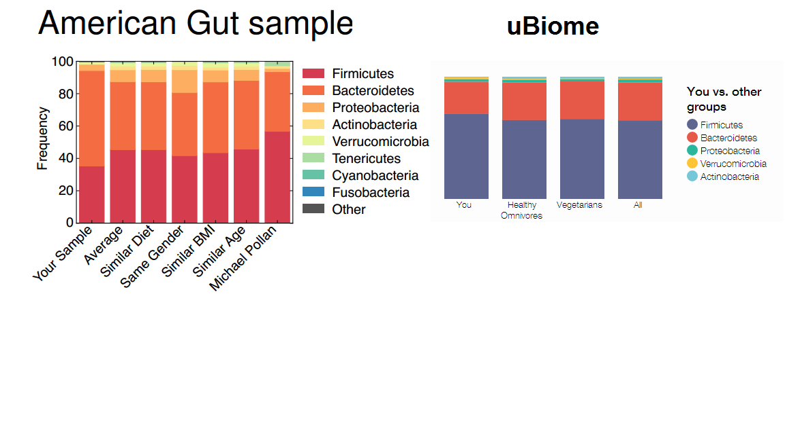
Is microbiome analysis reproducible?
🐯
🐞
👽
Engelhaupt ScienceNews 2014
Here’s the poop on getting your gut microbiome analyzed

Slide 4
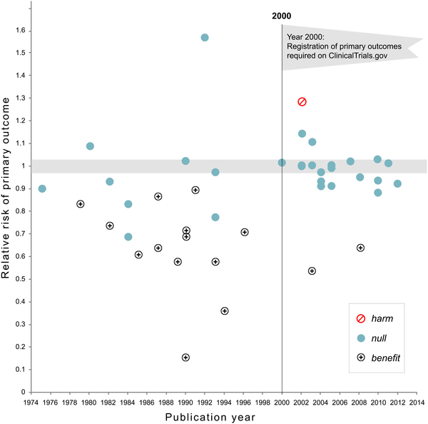

The importance of an analysis plan
NHLBI trials on pharmaceutical and dietary supplement
🐯
🐞
👽
Kaplan RM, Irvin VL (2015) Likelihood of Null Effects of Large NHLBI Clinical Trials Has Increased over Time. PLOS ONE 10(8): e0132382. https://doi.org/10.1371/journal.pone.0132382
https://journals.plos.org/plosone/article?id=10.1371/journal.pone.0132382
Notes:
Fig 1. Relative risk of showing benefit or harm of treatment by year of publication for large NHLBI trials on pharmaceutical and dietary supplement interventions.

Slide 5
Is microbiome analysis reproducible?
RDF are nearly infinite in the design
🐯
🐞
👽

Slide 6
RDF extends to the analysis
🐯
🐞
👽

Slide 7
We have a problem
Is it any wonder that different groups can get different answers about the same system?
Is it any wonder that so many datasets are irreproducible?
So much variation, no standard of truth
need to be first not the need to be correct
🐯
🐞
👽

Slide 8
A way out: functional but not microbial redundancy
🐯
🐞
👽
Louzupone et al Nature 2012

Slide 9
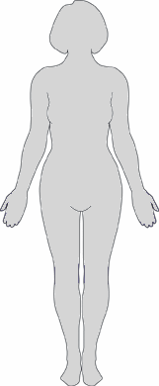
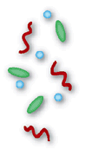
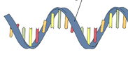
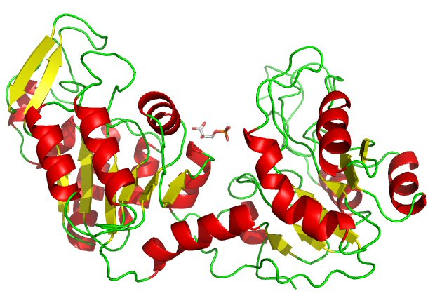
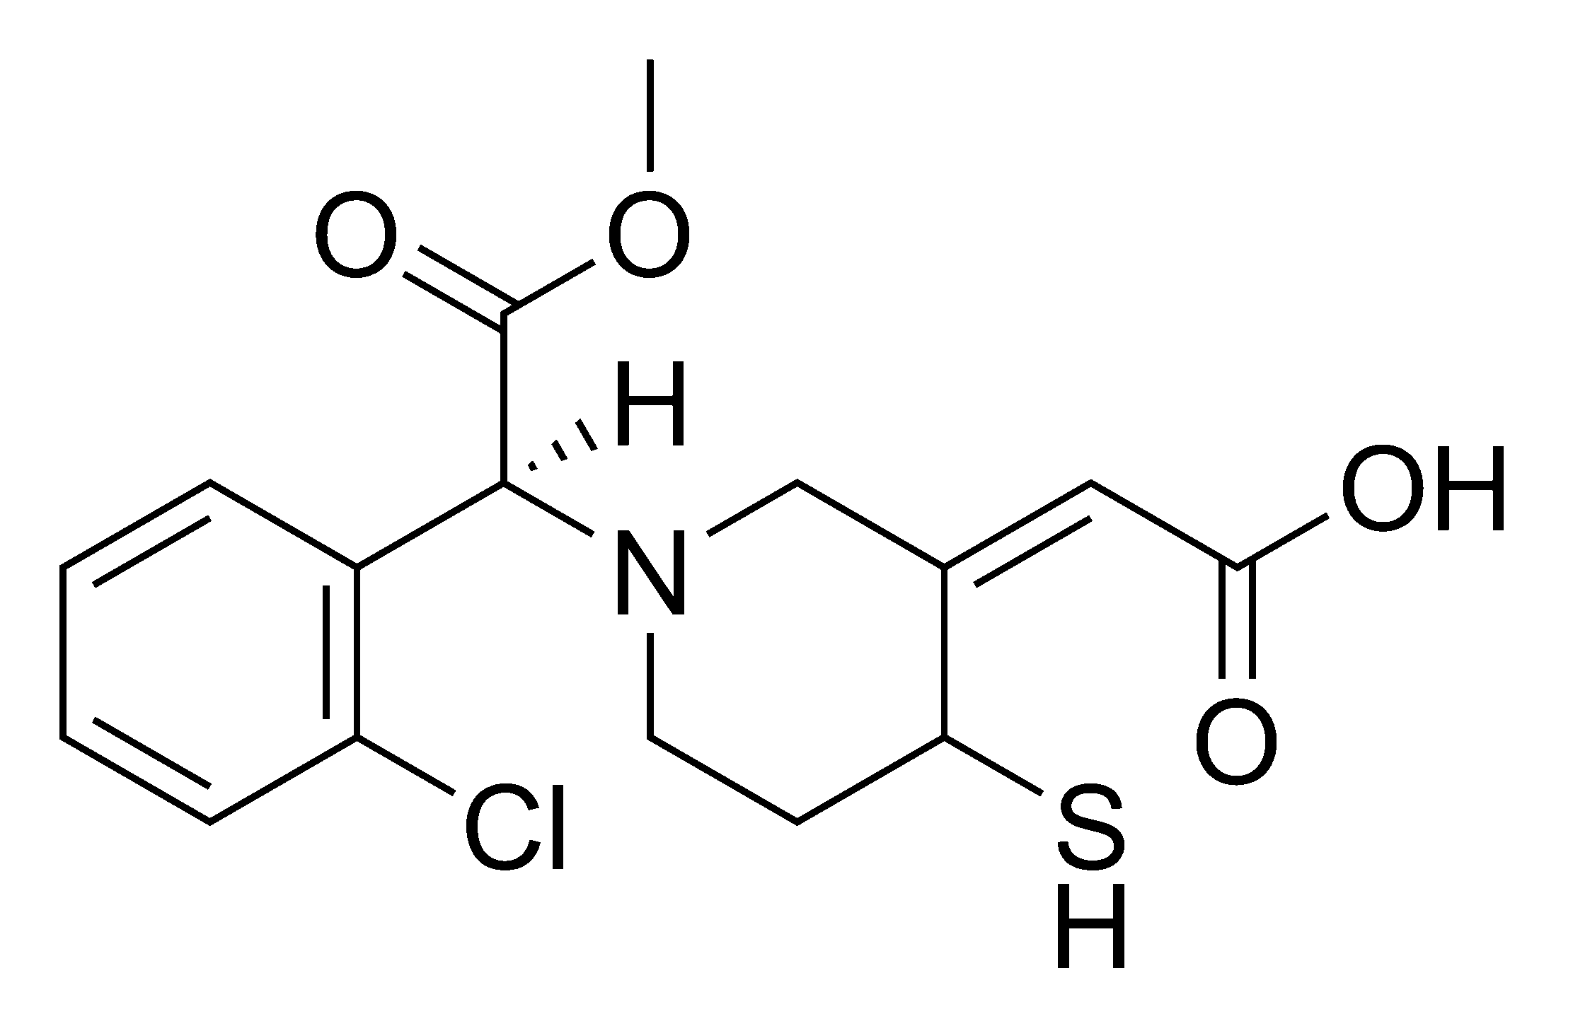

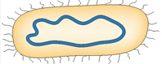
Getting to mechanism in the “meta-organism”
Jean Macklaim
Microbiome
Targeted amplicon seq (e.g. 16S)
🐯
🐞
👽
High-throughput sequencing
Metagenomics
Metatranscriptomics
Proteomics
Metabolomics
DNA
mRNA
Proteins
Metabolites
Macklaim, Gloor. From RNA-seq to Biological Inference: Using Compositional Data Analysis in Meta-Transcriptomics. MIMB 2018
Notes:
So there’s no doubt that microbes influence their environment
A major challenge of any microbiome investigation is to determine the role of the microbes in the environment, and the effects on the host or system
In terms of human health, there are many open questions of what (if any) role our resident microbiomes have on disease progression or maintenance of health, etc.
Different “levels” of using “high-throughput omics” to probe the microbiome
And these different levels seek to address: Who’s there, what are they capable of, what are they doing, what are they producing

Slide 10
Meta-OMICS are hard to analyze!
Bacterial species can differ
Gene content can differ
Gene expression can differ
Something must be invariant
Everything appears different
If everything is different, nothing is useful
Assumptions do not fit
Majority invariant
Dispersion ~ abundance
Data are centered
Model as NB or ZIG
zero is zero
Counts
🐯
🐞
👽
Notes:
MA plot of meta-transcriptome – each genetic function a point, red is statistically different. Black/orange are not
Clearly Breaks the assumptions of the tool
Note the midpoint of the dataset is off the 0 line
Note the centre of mass of expression is not linear and on the 0 line
Only a small fraction of genes appear invariant

Slide 11
Bacterial vaginosis - metatranscriptome
Bacterial species can differ
Gene content can differ
Gene expression can differ
Something must be invariant
Everything appears different
If everything is different, nothing is useful
Assumptions do not fit
Majority invariant
Dispersion ~ abundance
Data are centered
Model as NB or ZIG
zero is zero
Counts
🐯
🐞
👽

Slide 12
Bacterial vaginosis - metatranscriptome
Bacterial species can differ
Gene content can differ
Gene expression can differ
Something must be invariant
Everything appears different
If everything is different, nothing is useful
Assumptions do not fit
Majority invariant
Dispersion ~ abundance
Data are centered
Model as NB or ZIG
zero is zero
Counts
🐯
🐞
👽
Notes:
Breaks the assumptions
Note the midpoint of the dataset is off the 0 line

Slide 13
The sequencing meat grinder
🐯
🐞
👽
Assumptions do not fit
Counts
Majority invariant
Dispersion ~ abundance
Model as NB or ZIG
Correlation
Gloor, et al. 2016. Ann Epidemiology
Gloor, et al. 2016. Can J. Micro.
Gloor, et al, 2017. Front. Micro.

Slide 14
Sequencing is random sampling - election
🐯
🐞
👽
Gloor, et al. 2016. Ann Epidemiology
Gloor, et al. 2016. Can J. Micro.
Gloor, et al, 2017. Front. Micro.
Notes:
Starting with a of molecules composed of Tigers and Ladybugs
We take a random sample, how many Tigers and how many Ladybugs
If we count a given random area we can infer how many off each there are in entire set

Slide 15
Sequencing is random sampling - polling
🐯
🐞
👽
Gloor, et al. 2016. Ann Epidemiology
Gloor, et al. 2016. Can J. Micro.
Gloor, et al, 2017. Front. Micro.
Notes:
Starting with a of molecules composed of Tigers and Ladybugs
We take a random sample, how many Tigers and how many Ladybugs
If we count a given random area we can infer how many off each there are in entire set

Slide 16
Sequencing is polling
🐯
🐞
👽
Probability of count given sequencing depth and underlying frequency
Count
Gloor, et al. 2016. Ann Epidemiology
Gloor, et al. 2016. Can J. Micro.
Gloor, et al, 2017. Front. Micro.
Notes:
Starting with a of molecules composed of Tigers and Ladybugs
We take a random sample, how many Tigers and how many Ladybugs
If we count a given random area we can infer how many off each there are in entire set

Slide 17
Random data as counts
🐯
🐞
👽
Example 100 random sample sets
range=1800-2200
range= 8000-12000
range=450-550
🐯
🐞
👽
Gloor, et al. 2016. Ann Epidemiology
Gloor, et al. 2016. Can J. Micro.
Gloor, et al, 2017. Front. Micro.

Slide 18
Same random data after ‘sequencing’
🐯
🐞
👽
Constant sum
Sequencing
Percentage,probability, etc
Count normalization
Rarefaction
Obviously not numeric
Obviously correlation is problematic
Gloor, et al. 2016. Ann Epidemiology
Gloor, et al. 2016. Can J. Micro.
Gloor, et al, 2017. Front. Micro.

Slide 19
Normalization is no help at all
🐯
🐞
👽
Once data are on the simplex, they cannot be recovered without
⌛️ 💲 🏋🏼‍

Slide 20
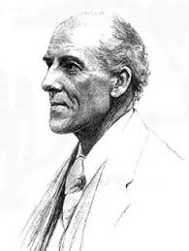
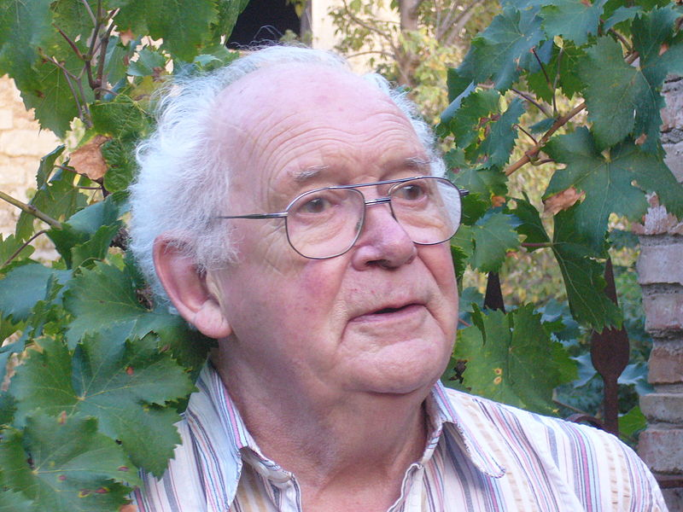
We have CoDa
🐯
🐞
👽
Compositional data are logically inconsistent with most tools in common use (Pearson 1897)
correlation, PCA etc.
Sequencing, negative binomial, rarefaction, ZIG
Work in log ratios
Aitchison and others
Conceptually similar to qPCR
X = [ x₁, x₂, … x_{D} ], g_{X} = geometric mean of X (or subset)
*lr(x) = [ log(x₁/g_{X}), log(x₂/g_{X}), … log(x_{D}/g_{X}) ]
Aitchison 1986

Slide 21
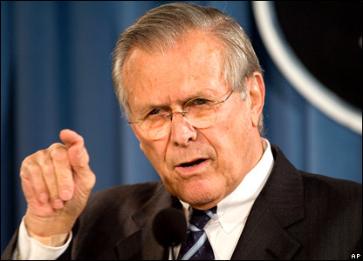
To sum up the theory
🐯
🐞
👽
There are known knowns. These are things we know that we know.
There are known unknowns. That is to say, there are things that we know we don't know.
But there are also unknown unknowns. There are things we don't know we don't know.
There are unknown knowns. These are things we think we know that we actually don’t know.

Slide 22
Back to Bacterial vaginosis
H is predominantly Lactobacillus sp.
BV is mixed bag of anaerobes with L. iners
Marked asymmetry in composition
We must assume something is invariant
Exploratory biplots
Differential abundance
🐯
🐞
👽

Slide 23
The CoDa approach
Backed by theoretical foundation
Not ad-hoc
Internally consistent
One standard approach
Probabalistic
Matches the data
Robust
Upstream decisions have little effect

Slide 24
The sample set by 16S rRNA gene sequencing
🐯
🐞
👽
Healthy
Bacterial Vaginosis (BV)
Notes:
Here’s as example to show you what I mean
This is the 16S rRNA gene sequencing output of the human vaginal microbiome. Each bar is a sample and each color is a taxonomic member of the community
Under typical healthy conditions is it a low diversity community with each sample dominated by one species of these blue Lactobacilli
A dysbiotic shift can happen where there is a drastic change to a high-diversity community called bacterial vaginosis (BV) on the right. You can hopefully see they are quite different communities
Click: Some organisms change abundance, like Lactobacillus iners
Click: Some organisms present in one condition are almost entirely absent in another like Atopobium

Slide 25
Metatranscriptomics (ie. meta-RNAseq)
Bacterial mRNA seq
🐯
🐞
👽
Reference genome CDS
Assembly of novel ORFs
90% sequence ID clustering: refseqs
Organism-specific
Read mapping
Group by SEED subsys4
Function
Macklaim, Gloor MIMB 2018
Notes:
This is a very distilled down workflow for how we generated the data
There are a few steps before, but we get to a point where we have enriched bacterial mRNA reads
We then do two things:
1. Collect putative coding sequences from reference genomes
Assemble de-novo and predict open reading frames (ORFs)
The sequences are clusters into 90% sequences identity refseqs that we map to
From these we retain the organism or taxonomic information
But we also take those refseqs and group them functionally using the SEED subsystem database

Slide 26
Abundance != function
Notes:
These are the same data I just showed you, but represented in taxonomic abundance barplots at both using 16S (top) and by mRNA (bottom)
By hierarchical clustering of the transcriptome, there are four main subgroups: two associated with health on the left in blue, and two associated with BV on the right
What I want to show you is the difference between the taxonomic contributions at the 16S level (the top plot) compared to the taxonomic contributions from the mRNA level (bottom plot)
This is summarized per taxon in the boxplots on the left
In some cases, like the blue L. crispatus organism, it’s punching above it’s weight and contributing more transcriptionally than you’d expect
And in other cases, like the white Atopobium organism there is hardly any transcriptional activity compared to the 16S abundance

Slide 27
Reference sequence pangenomes
🐯
🐞
👽
Variance of ratios of RefSeqs
~300000 RefSeqs
RefSeqs cluster
by ‘species’

Slide 28
Reference sequence
🐯
🐞
👽
Healthy samples also cluster by species
H2
BV-2
H1
BV-1

Slide 29
Reference sequence - BV
🐯
🐞
👽
BV-1
BV-2

Slide 30
Reference sequence - BV
🐯
🐞
👽
BV-1
BV-2

Slide 31
Refseq summary
🐯
🐞
👽
Massive sparse datasets
Refseqs group by taxonomy
Can be multiple ‘strains’
Samples group by taxonomy
Two types of healthy samples
Two types of BV samples

Slide 32
Grouping by function
🐯
🐞
👽
All reference sequences with the same function are combined
No longer taxonomic information
Looks at the ecosystem as a whole

Slide 33
Function - samples
Cell division protein MraZ
D-tyrosyl-tRNA(Tyr) deacylase
Deoxyuridine 5'-triphosphate nucleotidohydrolase (EC 3.6.1.23)
DNA ligase (EC 6.5.1.2)
FIGfam135315: Iojap-related protein
LSU ribosomal protein L3p (L3e)
Membrane-associated zinc metalloprotease
Peptide chain release factor 3
Ribosomal large subunit pseudouridine synthase B (EC 4.2.1.70)
Signal peptidase I (EC 3.4.21.89)
Transcription-repair coupling factor
Translation elongation factor Ts
tRNA nucleotidyltransferase (EC 2.7.7.21) (EC 2.7.7.25)
Tryptophanyl-tRNA synthetase (EC 6.1.1.2)
🐯
🐞
👽
BV-2
H-1,2
BV-1

Slide 34
Core functions assumed invariant
Housekeeping …
Cell division protein MraZ
D-tyrosyl-tRNA(Tyr) deacylase
Deoxyuridine 5'-triphosphate nucleotidohydrolase (EC 3.6.1.23)
DNA ligase (EC 6.5.1.2)
FIGfam135315: Iojap-related protein
LSU ribosomal protein L3p (L3e)
Membrane-associated zinc metalloprotease
Peptide chain release factor 3
Ribosomal large subunit pseudouridine synthase B (EC 4.2.1.70)
Signal peptidase I (EC 3.4.21.89)
Transcription-repair coupling factor
Translation elongation factor Ts
tRNA nucleotidyltransferase (EC 2.7.7.21) (EC 2.7.7.25)
Tryptophanyl-tRNA synthetase (EC 6.1.1.2)
🐯
🐞
👽
core

Slide 35
Function groups
🐯
🐞
👽
BV-2
BV = biosynthesis/TCA
H = aa/sugar
H
BV-1

Slide 36
Distinguishing functions
🐯
🐞
👽

Slide 37
Distinguishing functions
Chemotaxis protein CheC -- inhibitor of MCP methylation
Chemotaxis protein CheD
Chemotaxis protein CheV (EC 2.7.3.-)
Chemotaxis protein methyltransferase CheR (EC 2.1.1.80)
Chemotaxis response regulator …-glutamate methylesterase CheB (EC 3.1.1.61)
Positive regulator of CheA protein activity (CheW)
Signal transduction histidine kinase CheA (EC 2.7.3.-)
Flagellar basal-body rod protein FlgB
Flagellar basal-body rod protein FlgC
Flagellar basal-body rod protein FlgF
Flagellar basal-body rod protein FlgG
Flagellar biosynthesis protein FliS
Flagellar hook protein FlgE
Flagellar hook-associated protein FlgK
Flagellar motor rotation protein MotA
Flagellar motor rotation protein MotB
Flagellar motor switch protein FliG
Flagellar motor switch protein FliM
Flagellar motor switch protein FliN
Flagellar protein FliJ
Flagellin protein FlaB
Negative regulator of flagellin synthesis
3-keto-L-gulonate 6-phosphate decarboxylase
Carbon storage regulator
Catabolite repression HPr-like protein Crh
Glucosamine-1-phosphate N-acetyltransferase (EC 2.3.1.157)
GTP-sensing transcriptional pleiotropic repressor codY
Iron-sulfur cluster assembly scaffold protein IscU
Ornithine carbamoyltransferase (EC 2.1.3.3)
Protein export cytoplasm protein SecA ATPase RNA helicase (TC 3.A.5.1.1)
Pyridoxine biosynthesis glutamine amidotransferase, synthase (EC 2.4.2.-)
Pyrophosphate-energized proton pump (EC 3.6.1.1)
Serine phosphatase RsbU, regulator of sigma subunit
Serine-protein kinase rsbW (EC 2.7.11.1)
spore peptidoglycan hydrolase (N-acetylglucosaminidase) (EC 3.2.1.-)
Substrate-specific component ThiT of thiamin ECF transporter
Thiol peroxidase, Tpx-type (EC 1.11.1.15)
🐯
🐞
👽

Slide 38
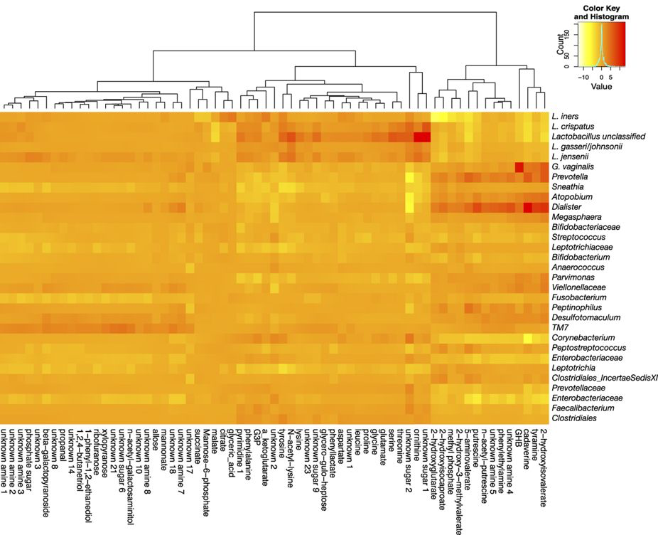
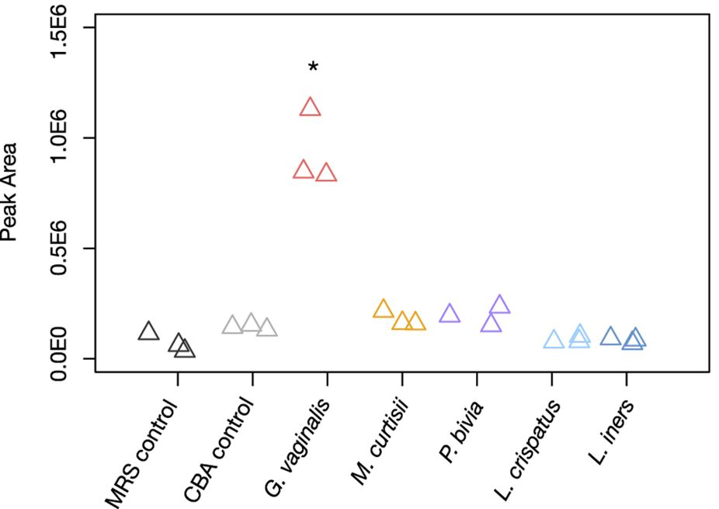
G. vaginalis correlates with GHB
G. vaginalis has part of the pathway to make GHB
G. vaginalis produces GHB in vitro
McMillanet al. 2015 Sci Rep

Slide 39
Is microbiome analysis reproducible?
The CoDa framework is robust a
Reflect properties of the entire composition
Not just most prevalent
Results replicate within and between labs
🐯
🐞
👽
Notes:
Compositional data is analyzed based on the variance of the ratios between parts. Regardless of the approach the first step is to replace 0 values prior to clr transformation. This is an open problem, but the best current approaches incorporate Bayesian estimation. I am developing CoDaSeq, an integrated toolkit that adapts the tools used for compositional data analysis in other domains to the analysis if HTS. With these tools we can find outliers, perform exploratory data analysis, examine differential abundance and find associated variables. The toolkit is applicable to many different HTS designs including transcriptome, metagenome and 16S rRNA gene sequencing. The latter will be used as an esample, since these data are the least tractable to the CoDa approach

Slide 40
Summary
Who is there, what they are doing and what they have done may or may not correspond between DNA, RNA, small molecules
Relationship status: it’s complicated but some successes
Combining different ‘omics data (e.g. mRNA and metabolites) remains an open problem
Metabolome + metaRNAseq provides a high-resolution, holistic view of a complex system
Agreements (H v BV: amines, succinate)
different resolution
Some functions are conserved regardless of the community members
Ecosystem is more important than any organism
Community members can cooperate, compete or ignore
🐯
🐞
👽
Notes:
----------------------------------
Inferring from 16S would be misleading: organism abundance and transcript abundance not necessarily related….and out to small molecules detected
Still need virome and proteome, etc.
Describing the functional diversity through transcriptomics gives insight to the response of bacteria to changes in environment and potential effects on host
A better “omics” understanding will allow us to target and modulate the microbiome in predictable ways

Slide 41
Examine variance of the ratios between features
Sequencing data are inherently compositional
Examine variance not abundance
Easily interpret relationships between samples and features
Robust to perturbations
Exploratory data analysis
Differential abundance
Compositional association
Results directly relevant to the ratios between the features in the environment
🐯
🐞
👽
Notes:
Compositional data is analyzed based on the variance of the ratios between parts. Regardless of the approach the first step is to replace 0 values prior to clr transformation. This is an open problem, but the best current approaches incorporate Bayesian estimation. I am developing CoDaSeq, an integrated toolkit that adapts the tools used for compositional data analysis in other domains to the analysis if HTS. With these tools we can find outliers, perform exploratory data analysis, examine differential abundance and find associated variables. The toolkit is applicable to many different HTS designs including transcriptome, metagenome and 16S rRNA gene sequencing. The latter will be used as an esample, since these data are the least tractable to the CoDa approach

Slide 42
Available tools
🐯
🐞
👽
Outliers & filters
CoDaSeq (github.com/ggloor)
Exploratory data analysis
Compositional biplots (compostions - CRAN)
omicplotR (Dan Giguere: github.com/dgiguer/omicplotR/wiki)
philr (Bioconductor)
Differential abundance
ALDEx2 (Bioconductor)
Selbal (?)
ANCOM (QIIME)
Compositional association
propr (CRAN)

Slide 43

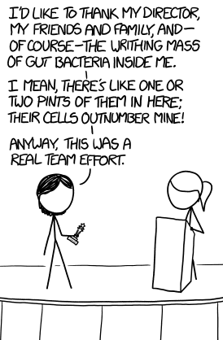


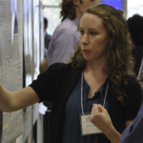



Acknowledgments
🐯
🐞
👽
Andrew
Fernandes
Jean
Macklaim
Vera Pawlowsky-Glahn
Juan Jose Egozcue
Justin Silverman
philr
Tom Quinn
propr
Gregor Reid
Jeremy Burton
Amy McMillan
Daniel Giguere
Jia Rong Wu
Notes:
Many more fragments than we can count

Slide 44
Metabolome – subset by NMR or GC-MS
NMR
GC-MS + M’tome
🐯
🐞
👽
McMillan, Sci. Rep. 2015

Slide 45
Greatest discriminator functions between BV1 and BV2?
🐯
🐞
👽
BV2
3-keto-L-gulonate 6-phosphate decarboxylase
Carbon storage regulator
Catabolite repression HPr-like protein Crh
Chemotaxis protein CheC -- inhibitor of MCP methylation
Chemotaxis protein CheD
Chemotaxis protein CheV (EC 2.7.3.-)
Chemotaxis protein methyltransferase CheR (EC 2.1.1.80)
Chemotaxis response regulator …-glutamate methylesterase CheB (EC 3.1.1.61)
Flagellar basal-body rod protein FlgB
Flagellar basal-body rod protein FlgC
Flagellar basal-body rod protein FlgF
Flagellar basal-body rod protein FlgG
Flagellar biosynthesis protein FliS
Flagellar hook protein FlgE
Flagellar hook-associated protein FlgK
Flagellar motor rotation protein MotA
Flagellar motor rotation protein MotB
Flagellar motor switch protein FliG
Flagellar motor switch protein FliM
Flagellar motor switch protein FliN
Flagellar protein FliJ
Flagellin protein FlaB
Glucosamine-1-phosphate N-acetyltransferase (EC 2.3.1.157)
GTP-sensing transcriptional pleiotropic repressor codY
Iron-sulfur cluster assembly scaffold protein IscU
Negative regulator of flagellin synthesis
Ornithine carbamoyltransferase (EC 2.1.3.3) Positive regulator of CheA protein activity (CheW)
Protein export cytoplasm protein SecA ATPase RNA helicase (TC 3.A.5.1.1)
Pyridoxine biosynthesis glutamine amidotransferase, synthase (EC 2.4.2.-)
Pyrophosphate-energized proton pump (EC 3.6.1.1)
Serine phosphatase RsbU, regulator of sigma subunit
Serine-protein kinase rsbW (EC 2.7.11.1)
Signal transduction histidine kinase CheA (EC 2.7.3.-)
spore peptidoglycan hydrolase (N-acetylglucosaminidase) (EC 3.2.1.-)
Substrate-specific component ThiT of thiamin ECF transporter
Thiol peroxidase, Tpx-type (EC 1.11.1.15)
Difference
BV1
Dispersion

Slide 46
Summary 1
🐯
🐞
👽
Macklaim, Macmillan unpublished
Macmillan Sic Rep 2015

